Slide 1

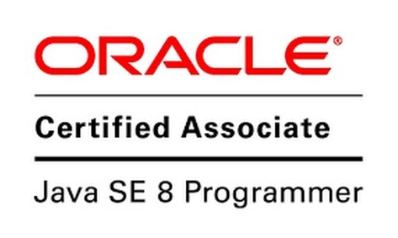
OCP 1Z0-809
Dr.-Ing Mohamed Amine Mezghich
Associate Professor at ENSI, CEO of Smart IT Partner
JAVA/J2EE Certified Trainer
ma.mezghich@smart-it-partner.com
amine.mezghich@ensi-uma.tn

Slide 2
Chapter 4 : Functional Programming Exam Essentials
1-Identify the correct functional interface given the number of parameters, return type, and method name—and vice versa. The most common functional interfaces are Supplier, Consumer, Function, and Predicate. There are also binary versions and primitive versions of many of these methods. 2-Write code that uses Optional. Creating an Optional uses Optional.empty() or Optional.of(). Retrieval frequently uses ifPresent() and get(). Alternatively, there are the functional ifPresent() and orElseGet() methods.

Slide 3
Chapter 4 : Functional Programming Exam Essentials
3-Recognize which operations cause a stream pipeline to execute. Intermediate operations do not run until the terminal operation is encountered. If no terminal operation is in the pipeline, a Stream is returned but not executed. Examples of terminal operations include collect(), forEach(), min(), and reduce(). 4-Determine which terminal operations are reductions. Reductions use all elements of the stream in determining the result. The reductions that you need to know are collect(), count(), max(), min(), and reduce(). A mutable reduction collects into the same object as it goes. The collect() method is a mutable reduction.

Slide 4
Chapter 4 : Functional Programming Exam Essentials
5-Write code for common intermediate operations. The filter() method returns a Stream filtering on a Predicate. The map() method returns a Stream transforming each element to another through a Function. The flatMap() method ﬂattens nested lists into a single level and removes empty lists. 6-Compare primitive streams to Stream. There are three primitive stream classes: DoubleStream, IntStream, and LongStream. There are also three primitive Optional classes: OptionalDouble, OptionalInt, and OptionalLong. There are a good number of functional interfaces for primitives. Aside from BooleanSupplier, they all involve the double, int, or long primitives.

Slide 5
Chapter 4 : Functional Programming Exam Essentials
7-Convert primitive stream types to other primitive stream types. Normally when mapping, you just call the map() method. When changing the class used for the stream, a different method is needed. To convert to Stream, you use mapToObj(). To convert to DoubleStream, you use mapToDouble(). To convert to IntStream, you use mapToInt(). To convert to LongStream, you use mapToLong(). 8-Translate coding using method references into lambdas and vice versa. All code that uses method references can be rewritten as a lambda. For example, stream.forEach(System. out::println) does the same thing as stream.forEach(x -> System.out.println(x)). Not all code that uses lambdas can be rewritten to use a method reference.

Slide 6
Chapter 4 : Functional Programming Exam Essentials
9-Use peek() to inspect the stream. The peek() method is an intermediate operation. It executes a lambda or method reference on the input and passes that same input through the pipeline to the next operator. It is useful for printing out what passes through a certain point in a stream. 10-Search a stream. The findFirst() and findAny() methods return a single element from a stream in an Optional. The anyMatch(), allMatch(), and noneMatch() methods return a boolean. Be careful, because these three can hang if called on an infinite stream with some data. All of these methods are terminal operations.
11-Sort a stream. The sorted() method is an intermediate operation that sorts a stream. There are two versions: the signature with zero parameters that sorts using the natural sort order, and the signature with one parameter that sorts using that Comparator as the sort order.

Slide 7
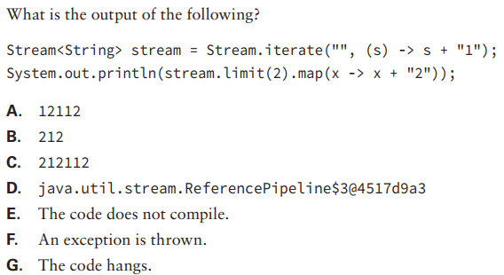

Chapter 4 : Functional Programming Review Questions
Q1)

Slide 8
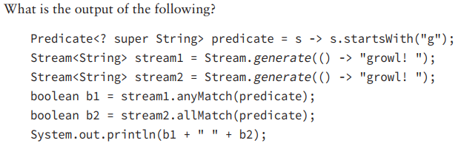
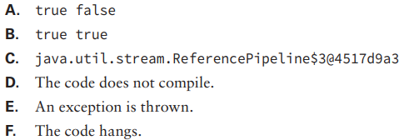

Chapter 4 : Functional Programming Review Questions
Q2)

Slide 9
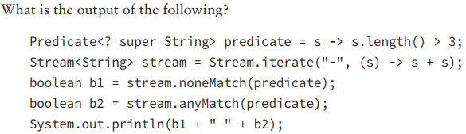
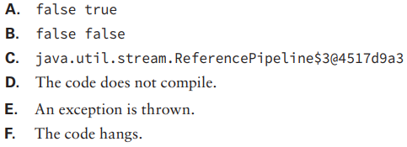

Chapter 4 : Functional Programming Review Questions
Q3)

Slide 10
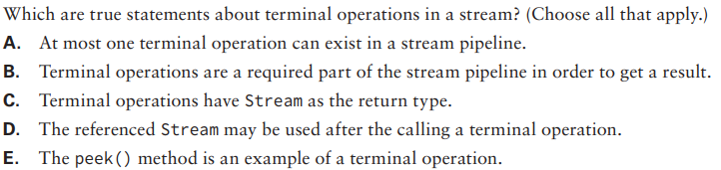

Chapter 4 : Functional Programming Review Questions
Q4)

Slide 11
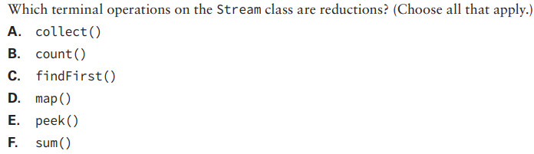

Chapter 4 : Functional Programming Review Questions
Q5)

Slide 12
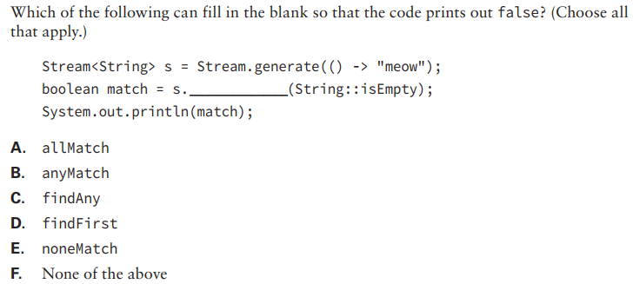

Chapter 4 : Functional Programming Review Questions
Q6)

Slide 13
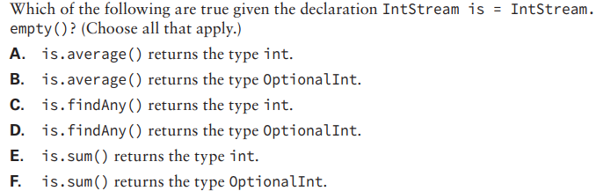

Chapter 4 : Functional Programming Review Questions
Q7)

Slide 14
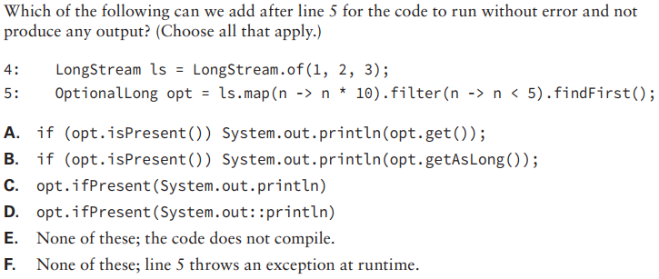

Chapter 4 : Functional Programming Review Questions
Q8)

Slide 15
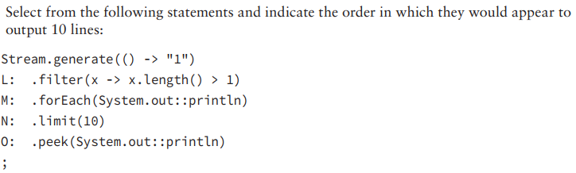
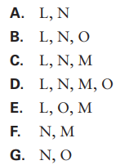
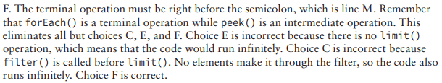
Chapter 4 : Functional Programming Review Questions
Q9)

Slide 16

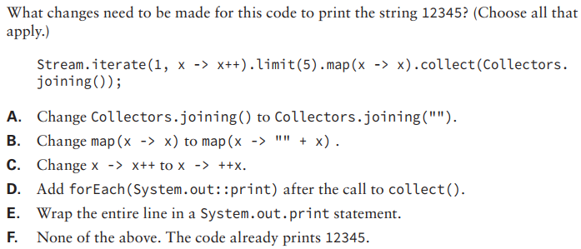
Chapter 4 : Functional Programming Review Questions
Q10)

